Slide 1
Narrative structure

Slide 2
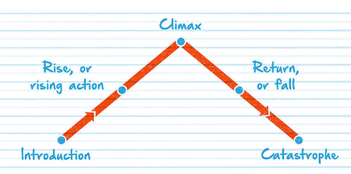
Freytag’s Pyramid

Slide 3
Introduction: Establish the characters and stakes.
Rise, or rising action: Things seem to be on the up.
Climax: The world is turned upside-down.
Return or fall: We’re heading for tragedy.
Catastrophe: The inevitable becomes true.

Slide 4
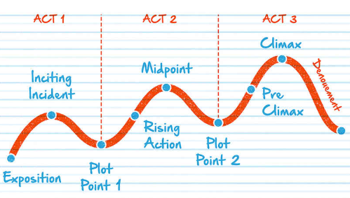
Three act structure

Slide 5
Act 1: Setup – Exposition, Inciting Incident, Plot Point One
Act 2: Confrontation – Rising Action, Midpoint, Plot Point Two
Act 3: Resolution – Pre-Climax, Climax, Denouement

Slide 6
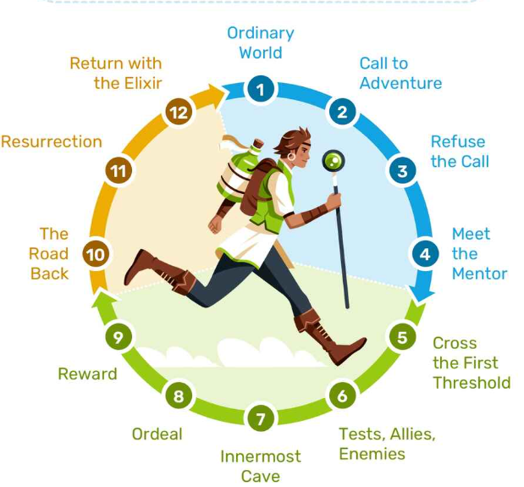
Hero’s journey

Slide 7
The Ordinary World: We meet our hero.
Call to Adventure: Will they meet the challenge?
Refusal of the Call: They resist the adventure.
Meeting the Mentor: A teacher arrives.
Crossing the First Threshold: The hero leaves their comfort zone.
Tests, Allies, Enemies: Making friends and facing roadblocks.
Approach to the Inmost Cave: Getting closer to our goal.
Ordeal: The hero’s biggest test yet!
Reward (Seizing the Sword): Light at the end of the tunnel
The Road Back: We aren’t safe yet.
Resurrection: The final hurdle is reached.
Return with the Elixir: The hero heads home, triumphant.

